Slide 1
Student Reflective Self-Evaluation of Class Participation
Focus on Teaching and Learning
Loyola University Chicago
January 12, 201
John Orwat
Marcia Spira
School of Social Work
Notes:
Having students engaged in discussion is an increasingly important and common aspect of the classroom…in diverse disciplines…even law, math, physics…
This means instructors have to identify strategies to encourage and evaluate effectively.
But, also, go beyond that…how do we work with students to develop their own voice and take responsibility for this?
Today: Present tool. Present process.
Thanks for letting us share what we’ve been working on in this arena.

Slide 2
Class participation*
Improves critical thinking and mastery of material (Dancer & Kamvounias, 2005)
Advances active learning (Woolridge, 2008)
Livens dry material (Magel, 1996)
Develop listening and speaking skills (Hayes & Hayes, 1973)
Professional development (Woolridge, 2008)
Increase classroom engagement (Elliot, 1993)
Discipline specific conversation/ learn
how to use language of the discipline
*As cited in Heyman, J.E., Sailors, J.J.
Notes:
Ignatian Pedagogy and Transformative Education
A Jesuit education seeks to address the desire for a wholeness and peace in the contemporary world. Our kind of education seeks to stir and meet these desires in our students and faculty.
5 “Hungers” we identify and choose to foster in our students:
Integrated Knowledge
A Moral Compass
Civic Participation
A Global Paradigm
An Adult Spirituality

Slide 3
Class Participation: Toward a Definition
Depends on class size, content area, instructor preferences, etc. Various models.
In general, class participation is when
  Students are engaged in material and class activities (not just awake)
  Students actively and collaboratively engaged with each other & instructor in learning/experience of course material
  Students are transformed from the classroom experience
  What else? How do you define “transformed” in this context?

Slide 4
But, how do we incent students to participate?
Motivate students: explain why class participation important
Atmosphere: get to know students, build rapport, icebreakers, small group work
Environment: seating arrangement
Activities: assign discussion roles, poker chips for speaking
Class participation as part of grade (Students
tend to what is graded)
Notes:
So, we know a good idea, but how do we do it?

Slide 5
Grading is rife with challenges…
Criteria often not clear and difficult to objectify
Hard to justify if student challenges
Instruction rarely given on where and how to improve
Often used as ‘fudge factor’
Based on student personality (shy or introverted)?
Record keeping
Students start at different places and have different goals
Imposed by instructor
Notes:
Many scholars advise against…many struggle with assessing class participation and students struggle to accept those assessments.
Cannot expect a “shy” student to engage as do more “talkative” students do
In many ways, these criteria are important for good teaching and transformative education.

Slide 6
So…
If class participation is an important part of academic and professional development, how do we develop this with students?
How do we incent students to participate in such a way that is congruent with transformative education?
How do we communicate that both instructor and student have roles in the class environment?
Notes:
MANY possibilities, but how incorporate student reflection?
Considering important and possible, but

Slide 7
Reflective self assessment of class participation
Self assessment
Goal setting
Continuous evaluation
Mid-term review
Final evaluation
Notes:
So, propose this process that is full of reflection.

Slide 8
Reflective self assessment of class participation
Self assessment
Goal setting
Continuous evaluation
Mid-term review
Final evaluation

Slide 9
Self assessment
The ability to observe, analyze, and judge one’s own performance on the basis of some criteria and determine ways to improve it.
Helps determine each student’s unique degree of success
Essential for life long learning
Reflection required for self assessment

Slide 10
Self assessment
Students complete assessment tool.
Not a rubric or set of expectations, but an opportunity to assess.
Instructors may adapt tool based on teaching style/goals (e.g., call outs, small group work).
On Blackboard:
  create a folder containing each step
  Use test function
Notes:
Hand out tool…but, this is more for example than anything…attempts to capture domains.
May adapt.
May use lickert scale.

Slide 11
Reflective self assessment of class participation
Self assessment
Goal setting
Continuous evaluation
Mid-term review
Final evaluation

Slide 12
Goal setting
Based on self assessment, identify 3 measureable goals for semester.
  For each goal, what will define an A, B, C?
  Include discrete steps in reaching goals as well as timeframes.
  Instructor may modify based on how conduct course. May require one goal from each domain.
Consider offering suggestions for goals
On Blackboard:
  Test function: suggest goals in “feedback”
Notes:
Consider stages of change here?

Slide 13
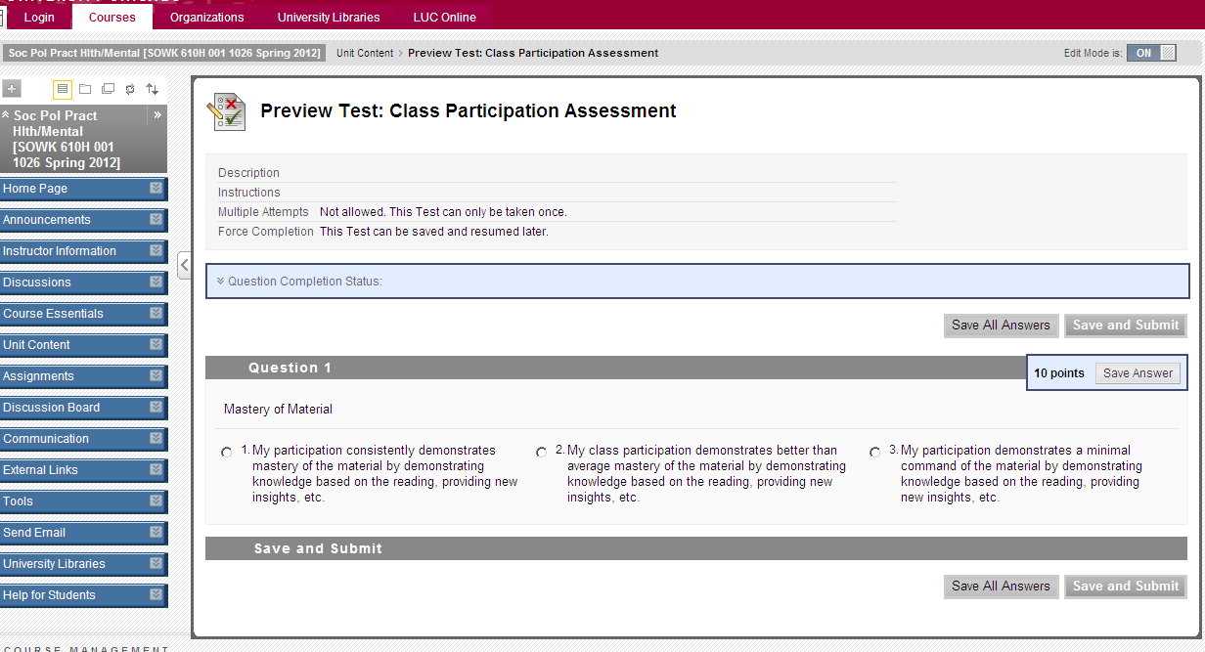
Assessment on Blackboard

Slide 14
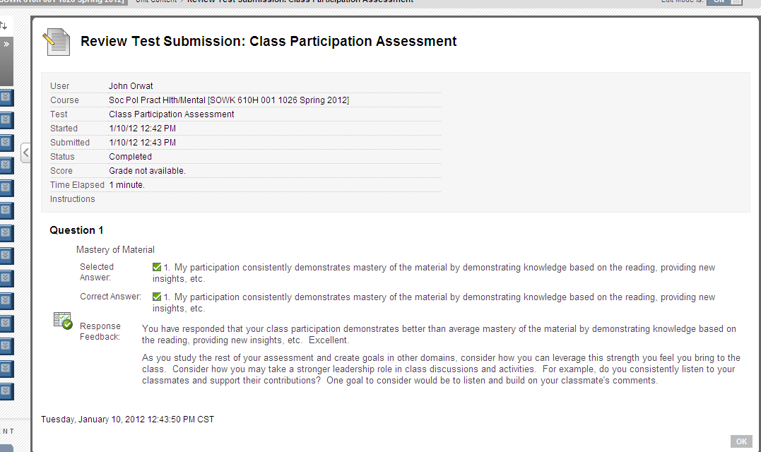
Assessment on Blackboard

Slide 15

Assessment on Blackboard

Slide 16
Goal setting
Examples:
  Prepare 3 statements prior to class based on the course reading that I find interesting and would be interesting to discuss.
  Make at least two statements in class that builds on a classmate’s comments.
  Initiate a class conversation at least once per week.
  Since I feel my thoughts are often unclear, write out my comments on a piece of paper prior to speaking.

Slide 17
“I’m very talkative in class…”
I recently read something citing Buddhist practice as a source of these think-before-you-speak questions: Is it true? Is it necessary? Is it kind? One of my first goals is to ask myself these questions. (Truth might be more like "relevance" with regard to class. Anyway, all yes answers before I speak would be a "A," maybe is a "B," and no for all three is a "C.")
Actively listen. If I can listen without interrupting, and actually feel myself compelled to listen more and remember that listening is not just waiting for my turn to talk= A. Less so= B. No listening and feeling like i didnt learn anything from my classmates=C. (Learning from my classmates is my responsibility and duty to be open.)
Prepare more from the readings for class. Have a question ready for class. Furthermore, ask questions rather than only posing insight or providing anecdotes. >1 question = A. 1 question= B. Simply insight/comment = C.

Slide 18
Reflective self assessment of class participation
Self assessment
Goal setting
Continuous evaluation
Mid-term review
Final evaluation

Slide 19
Continuous evaluation
For each class period, students journal progress toward each goal.
  Instructor “checks in” at specific weeks or randomly
  Specific examples/evidence from class.
  Journal or blog
    If blog (e.g., open to class) may use peer assistance, evaluation, suggestion.
On Blackboard
  Use journal or blog function: consider
  privacy vs. accountability.
Notes:
Consider weekly “grade” for journal so students receive immediate feedback.

Slide 20
Continuous evaluation: Guided Questions
How have the following impeded/facilitated your progress?
  The class process
  The experience of your personal participation level
  The instructor’s style/method of teaching
  The class environment (classroom, desk arrangements, climate, time of day)
What strategies/options did you consider?
Which did you select?
How did the solution work out?
What will you do differently next time?
Notes:
Pay particular attention to:
Times you have drifted from goals and how you got back on track.
Solutions to the aspects that have impeded progress.

Slide 21
Continuous Evaluation:
Problem solving strategy
Understand the problem
Explore strategies/options
Select and implement a solution
Evaluate the solution
Start over

Slide 22
Ignatian Pedagogy, a style of teaching
See/
Observe
Ignatian
Pedagogy
Reflect/
Discern
Think/
Analyze
Act/
Respond

Slide 23
Reflective self assessment of class participation
Self assessment
Goal setting
Continuous evaluation
Mid-term review
Final evaluation

Slide 24
Mid-term review
At mid-term, review goals and progress toward goals.
  One page review of progress toward goals, identification of facilitators/barriers to accomplishment of goals.
  Review of past term using problem solving process.
  New goals/ action steps?
Faculty provides feedback.

Slide 25
Mid-term review
In class:
  Students come prepared with each goal, action steps, facilitators and barriers, how overcame.
  Students post one barrier having difficulty overcoming written on newsprint.
  In small groups, students roam to each newsprint and write suggestions/action steps.
On Blackboard:
  Students post on discussion board.

Slide 26
Reflective self assessment of class participation
Self assessment
Goal setting
Continuous evaluation
Mid-term review
Final evaluation

Slide 27
Final review
Short paper:
Review of progress toward goals.
Based on your progress, what grade would you expect?
Provide evidence/support from journal.
Consider retaking self assessment.
Goals for future classes/groups?

Slide 28
Student self assessment of class participation: Next Steps
Pilot across SSW curriculum
  When employ in cirriculum?
  How tailor based on specific course/type of course?
  Tool refinement
How use within other teaching tools?
  Peer assessment
Evaluation
  Evaluate related to student satisfaction

Slide 29
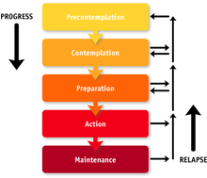
Student self assessment of class participation: Goal setting
Stages of Change
Notes:
Stages of Change from the Transtheoretical Model.
In the Transtheoretical Model, change is a "process involving progress through a series of stages":[25]
Precontemplation –(Not Ready) "People are not intending to take action in the foreseeable future, and can be unaware that their behaviour is problematic"
Contemplation –(Getting Ready) "People are beginning to recognize that their behaviour is problematic, and start to look at the pros and cons of their continued actions"
Preparation –(Ready) "People are intending to take action in the immediate future, and may begin taking small steps towards behaviour change"[nb 1]
Action – "People have made specific overt modifications in modifying their problem behaviour or acquiring new healthy behaviours"
Maintenance – "People have been able to sustain action for awhile and are working to prevent relapse"
Termination – "Individuals have zero temptation and they are sure they will not return to their old unhealthy habit as a way of coping"[nb 2]
In addition, the researchers conceptualized "relapse" (recycling) which is not a stage in itself but rather the "return from action or maintenance to an earlier stage."[25][nb 3]
[edit]
Stage details
This section does not cite any references or sources. Please help improve this section by adding citations to reliable sources. Unsourced material may be challenged and removed. (February 2011)
Stage 1: Precontemplation (Not Ready) People at this stage do not intend to start the healthy behavior in the near future (within 6 months), and may be unaware of the need to change. People here learn more about healthy behavior: they are encouraged to think about the Pros of changing their behavior and to feel emotions about the effects of their negative behavior on others.
Precontemplators typically underestimate the pros of changing, overestimate the cons, and often are not aware of making such mistakes. These individuals are encouraged to become more mindful of their decision making and more conscious of the multiple benefits of changing an unhealthy behavior.
Stage 2: Contemplation (Getting Ready) At this stage, participants are intending to start the healthy behavior within the next 6 months. While they are usually now more aware of the pros of changing, their cons are about equal to their Pros. This ambivalence about changing can cause them to keep putting off taking action.
People here learn about the kind of person they could be if they changed their behavior and learn more from people who behave in healthy ways. They're encouraged to work at reducing the cons of changing their behavior.
Stage 3: Preparation (Ready) People at this stage are ready to start taking action within the next 30 days. They take small steps that they believe can help them make the healthy behavior a part of their lives. For example, they tell their friends and family that they want to change their behavior.
People in this stage are encouraged to seek support from friends they trust, tell people about their plan to change the way they act, and think about how they would feel if they behaved in a healthier way. Their number one concern is: when they act, will they fail? They learn that the better prepared they are the more likely they are to keep progressing.
Stage 4: Action People at this stage have changed their behavior within the last 6 months, and need to work hard to keep moving ahead. These participants need to learn how to strengthen their commitments to change and to fight urges to slip back.
People in this stage are taught techniques for keeping up their commitments such as substituting activities related to the unhealthy behavior with positive ones, rewarding themselves for taking steps toward changing, and avoiding people and situations that tempt them to behave in unhealthy ways.
Stage 5: Maintenance People at this stage changed their behavior more than 6 months ago. It is important for people in this stage to be aware of situations that may tempt them to slip back into doing the unhealthy behavior—particularly stressful situations.
It is recommended that people in this stage seek support from and talk with people whom they trust, spend time with people who behave in healthy ways, and remember to engage in alternative activities to cope with stress instead of relying on unhealthy behavior.
We will divide the semester into time frames and assess progress at each one of these junctures. The objective is to determine if there are natural times during the semester when participation drops and progress toward the goals is halted or at least slowed.
The hypothesis is that readiness for change/learning within the assessed domains changes during the course of the semester. In fact a general trend toward progress or stagnation may become apparent during the respective time frames of the semester.

